Slide 1


K.RAMAKRISHNAN COLLEGE OF TECHNOLOGY
(AUTONOMOUS), TRICHY
DESIGN PROJECT –II
SMART HEAD LAMP
PRESENTED BY
811721105007-DHINAKARAN S
811721105020-LOKESH K
811721105032-PRIYADHARSAN A S
811721105033-RAJAGANAPATHY M
Guided by
Dr.R.MADAVAN
Prof/EEE
,

Slide 2
PRESENTATION OVERVIEW
Problem Identification
Objective
Existing system
Block diagram of existing system
Disadvantages of existing system
Proposed system
Block diagram of proposed system
Explanation of proposed system
Algorithm of proposed system
Hardware required
Application of Proposed work
References

Slide 3
PROBLEM IDENTIFICATION
Conventional high intensity headlights in vehicles can cause glare, which can temporarily blind drivers, making it difficult for them to see the road clearly.
Bright or flickering headlights can distract drivers, potentially leading to accidents or near misses as attention shifts away from the road.
While headlights are essential for visibility at night, they may not always illuminate the road adequately. Poorly designed or dim headlights can limit a driver's ability to see obstacles, pedestrians, or animals on the road.

Slide 4
OBJECTIVE
To design a automatic headlight intensity adjusting device for minimizing the risk of accidents and improving overall road safety.
To develop a solution that enhances driving comfort by automatically adjusting headlight brightness based on surrounding conditions, such as oncoming traffic, ambient light levels, and road curvature.

Slide 5
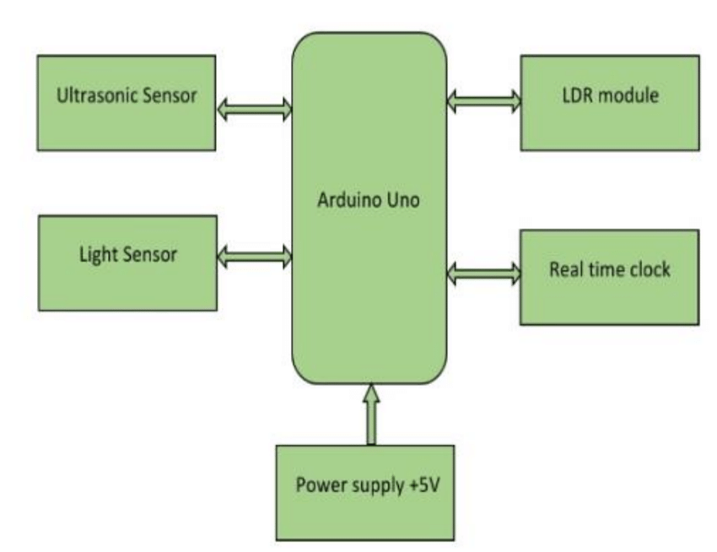
EXISTING SYSTEM
BLOCK DIAGRAM

Slide 6
DISADVANTAGES OF EXISTING SYSTEM
In this system the head light adjusted by using the LDR and ultrasonic sensor.
It doesn’t detect the vehicle arrival it just dim the light when the sensors sense and give a signal to the arduino
Even when any of the person or thing arrival it just din the lamp it may leads to accident
And this system may consume more power and it require two lamps to do an dimming process.

Slide 7
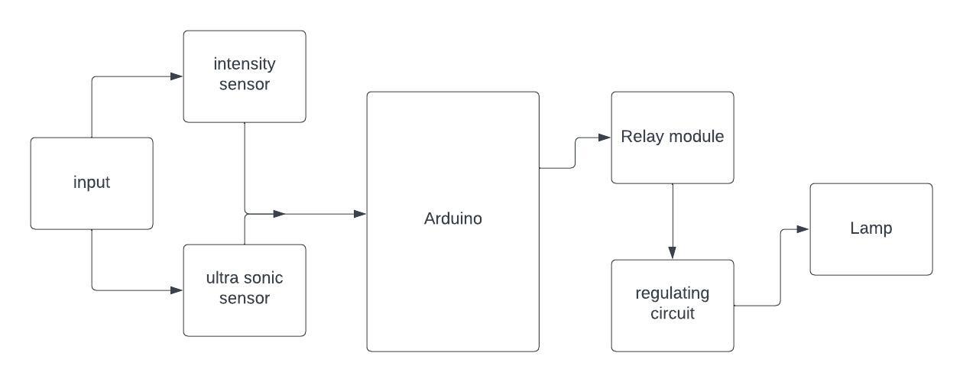
PROPOSED SYSTEM
BLOCK DIAGRAM
.

Slide 8
EXPLANATION OF PROPOSED WORK
In this proposed system, we measure the intensity of the opposite lamp and according to that brightness of the lamp is getting adjusted. This is done by using the intensity sensor, voltage regulator, arduino controller and sensors. This system reduce the power consumption of the lamp is minimum

Slide 9
Algorithm of proposed system
STEP 1: The intensity of the opposite sided lamp is determined by the light intensity sensor
STEP 2: The measured intensity is given to the controller
STEP 3: The controller regulates the supply voltage of the lamp
STEP 4: The intensity of the lamp is adjusted according to the voltage regulator circuit.
STEP 5: This process continuously done based on the headlight intensity of opposite vehicles.

Slide 10
Hardware required
Light intensity sensor
Ultra sonic sensor
Arduino
Relay
Voltage regulator circuit
Lamp

Slide 11
Application of Proposed work
Vehicles
Traffic lights
To avoid accidents
Mine travels

Slide 12
References
https://nevonprojects.com/sensor-based-projects
https://www.projectsof8051.com/light-sensor-projects

Slide 13
THANK YOU

